Slide 1
The HEPAS project: context, objectives and framework
Your logo

Slide 2
Context: Moving Schools Award
The Award values the achievements of schools in physical activity, physical education and school sport.
It is gained through an online self-assessment process and it consists of two phases.
The first step is for schools to register on the website to take part. By registering schools become part of the Moving Schools Award network.
https://www.movingschoolsaward.com/

Slide 3
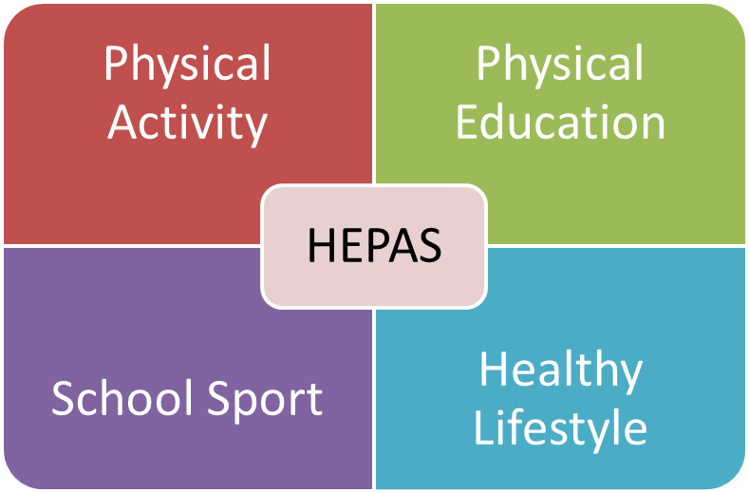
Healthy and Physically Active Schools in Europe
Follow-up project
Erasmus+ Key Action 2: Cooperation for innovation and the exchange of good practices
KA201 - Strategic Partnerships for school education supporting innovation
Healthy lifestyle and physically activity in school settings can be promoted through developments in four domains:

Slide 4
Healthy and Physically Active Schools in Europe
Objectives
The proposed project is aimed at building up capacity of school-related stakeholders - like teachers, educators, school headmasters – when it comes to the improvement of school-based physical activity for children and adolescents, as well as their healthy lifestyles in general.

Slide 5
Project objectives
Target groups
The main target groups are:
Teachers, school educators and school masters, representing schools as relevant educational target institutions
Children and adolescents, as school aged target population attending schools as the relevant educational target institutions

Slide 6
Project partners
Project partners
1. University of Luxembourg, Luxembourg (UL; project coordinator)
2. Hungarian School Sport Federation (HSSF), Hungary
3. Deporte para la Educacion y la Salud (DES), Spain
4. International Sport and Culture Association (ISCA), Denmark
5. European Physical Education Association (EUPEA), Luxembourg
Associated partners
12 associated partners are going to contribute to the project, of which 6 are ISCA members and 6 are EUPEA members

Slide 7
Project partners
ISCA member partners
AP 1: Romanian Sport for All Association (FRSPT), Romania
AP 2: BG Be Active, Bulgaria
AP 3: MOVE Malta, Malta
AP 4: Envercevko, Turkey
AP 5: Portuguese Institute for Sport and Youth (IDPJ), Portugal
AP 6: Albanian School Sport Federation, Albania
EUPEA member partners
AP 7: Scottish Association of Teachers of Physical Education (SATPE), Scotland/UK
AP 8: North Western Counties Physical Education Association (NWCPEA), England/UK
AP 9: Czech Society of Physical Education Teachers (CSPET), Czech Republic
AP 10: Confederazione delle associazioni provinciali dei diplomati ISEF e dei laureate in scienze motorie (CAPDI-LSM), Italy
AP 11: Svenska Idrottslärarföreningen (SI), Sweden
AP 12: Association of Physical and Health Educators (LIITO), Finland

