Slide 1
The HEPAS Guidelines for Implementation
Your logo

Slide 2
The structure and role of the Guidelines
The Guidelines contains the most important information a school needs to know about HEPAS, and about being a Healthy and Active School.
It also provides a structure which could be the basis of the schools’ work and the support from the multiplier organization.
Therefore, it provides a theoretic overview as well as a practical standpoint.

Slide 3
Table of contents
1. The Healthy and Active School Model
2. The five dimensions
Definition and categories
Summary from the Literature review
Recommendations
Good examples
3. The process of becoming a Healthy and Active School
The process in general
“Intervention Spiral”
4. Recommendations on starting a program
First steps
Things to consider before intervention

Slide 4
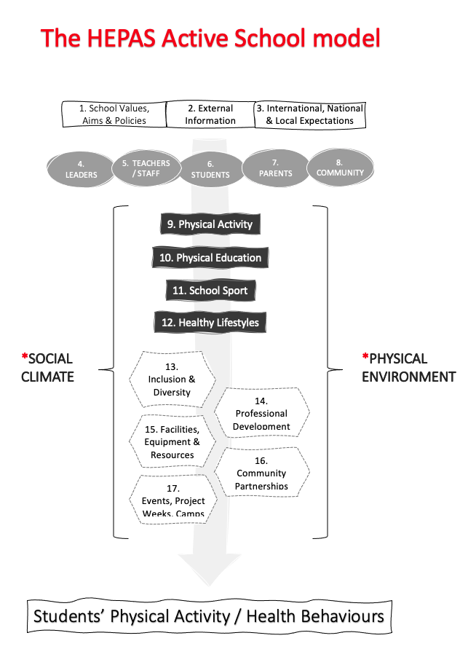
The HEPAS Model

Slide 5
The dimensions
Definition and categories
Summary from the Literature review
Recommendations
Good examples
(last presentation)

Slide 6
A model of PA opportunities at school
(Scheuer & Bailey, 2020)

Slide 7
Becoming a HEPAS school: Process, recommendations and sustainability
Your logo

Slide 8
The “Intervention spiral”
The growth of the extent and depth of the spiral shows the nature of properly implemented PA programs in schools, when during the activities, lessons, active breaks and recesses, etc. more and more students and teachers get involved, more and more experience and knowledge will gather, which will support the evolution of the intervention.

Slide 9
The phases of intervention
Assess – Structurally recognizing the current situation of the school’s attitude and providing health and physical activity is an essential step
It gives the fundamentum from where the development and the changes will start.
It also gives a better understanding for those who will be involved in the implementation, by getting to know the HEPAS framework, the content of certain dimensions, etc.
Plan – Each and every school is different, therefore each and every school’s needs, possibilities, “pains and gains” are different.
From the success of the intervention (and sustainability), it is very important to take the time and effort to examine the school’s needs, properly plan the activities (who, what, when and how?), and based on this, to set goals and a possibly school-specific vision (future-oriented thinking).

Slide 10
The phases of intervention
Do - The actual implementation of the planned activities, bearing in mind the characteristics of the dimensions and the different types of activities.
Also, formative assessment and evaluation are very much needed, as there will be experiences and feedbacks during the activities which definitely need the attention of those who are responsible for the interventions.
A larger and diverse team, involving school personnel, students and families will speed up the process in front of a single person or little team trying to push the active and healthy school project.
Adapt – Evaluating (as a summative assessment) the effect of the interventions is important to fine tune the activities, to understand what worked and what did not, and to see more clearly what the needs of the students and teachers (and staff) are.

Slide 11
Recommendations on starting a program
Setting up a team
One person who will be the responsible facilitator
PE teacher(s)
Principal
Experts who understand the functions of the school (what kind of formal and non-formal constraints are tying the school, like regulations, rules, etc.)
Communication
Connecting the teacher staff, parents, other stakeholders
Helping to understand the importance and values of HEPAS among all participants
Partnerships
Identifying local partnership possibilities who could be advantageous for the interventions (parents, municipality, sport clubs, etc.)

Slide 12
Thoughts to consider
Start small, think forward – the easier the goal at first, the better the chance to reach it. A culture of physical activity and health in a school is not something that can be built in a day, but it needs to be built every day, in little steps.
Everybody is important – from students to teachers, custodial to principal, everybody is part of the school community, and therefore everybody is responsible and contributing in a way to the “PA climate” of the school. Those who know their roles, goals, importance and responsibilities within the system, are more likely to contribute positively to the “PA climate”.
Every action counts that was taken toward a more physically active school community, toward a Healthy and Physically Active School.

